Slide 1
Learning Summary
Track2 team4 yuleyi

Slide 2
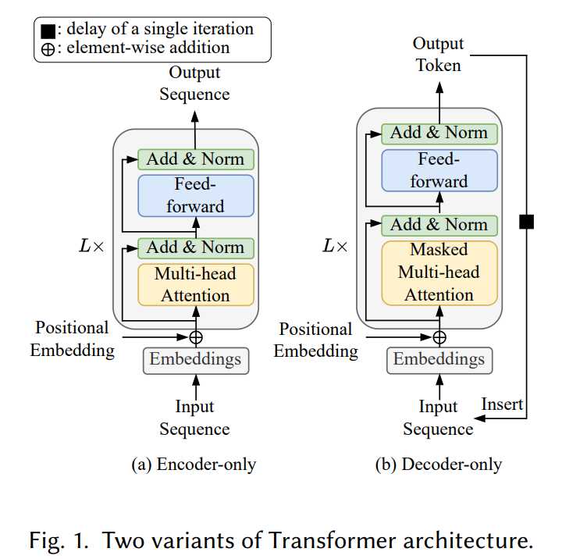
INTRODUCTION
Reduce cost :
Weight compute; Intermediate activations.
2. Balance between Low Cost and Accuracy Degradation
3. Category: Pruning, Quantization
Low-ranking approximation

Slide 3
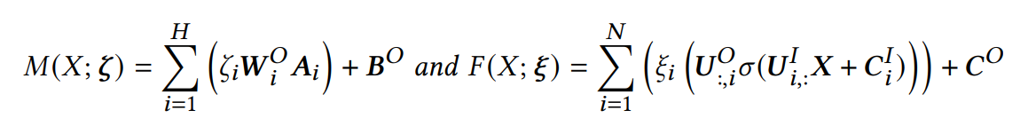
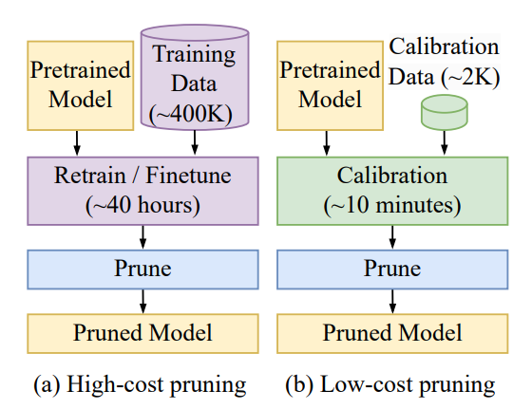
Pruning
Definition: Identify and Remove unnecessary weights
Important Factor: Granularity
From Small to Large: Weight, Neuron, Attention head, Embedding dimension, Sublayer, Layer, Token
High-cost & Low-cost

Slide 4
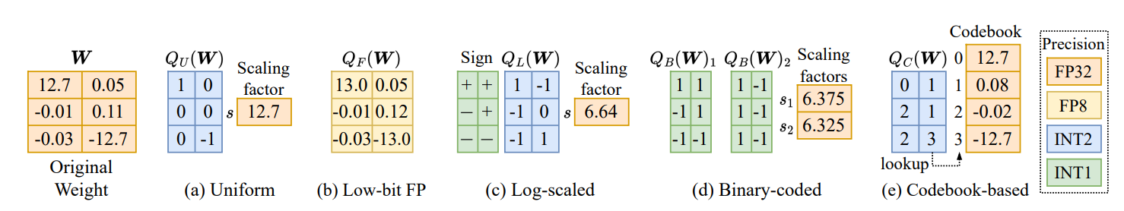
Quantization
Definition: Reduce the bit-length for representing weights
Method: Continuous values a small and discrete set
Levels: Uniformity, Precision and Type
Quantization Scheme

Slide 5

LoRA
Low-rank approximation
Parameters are low-ranked
Weights
Multiplication of low-dimensional matrices
Reduce memory footprint
low-rank adaptors

Slide 6
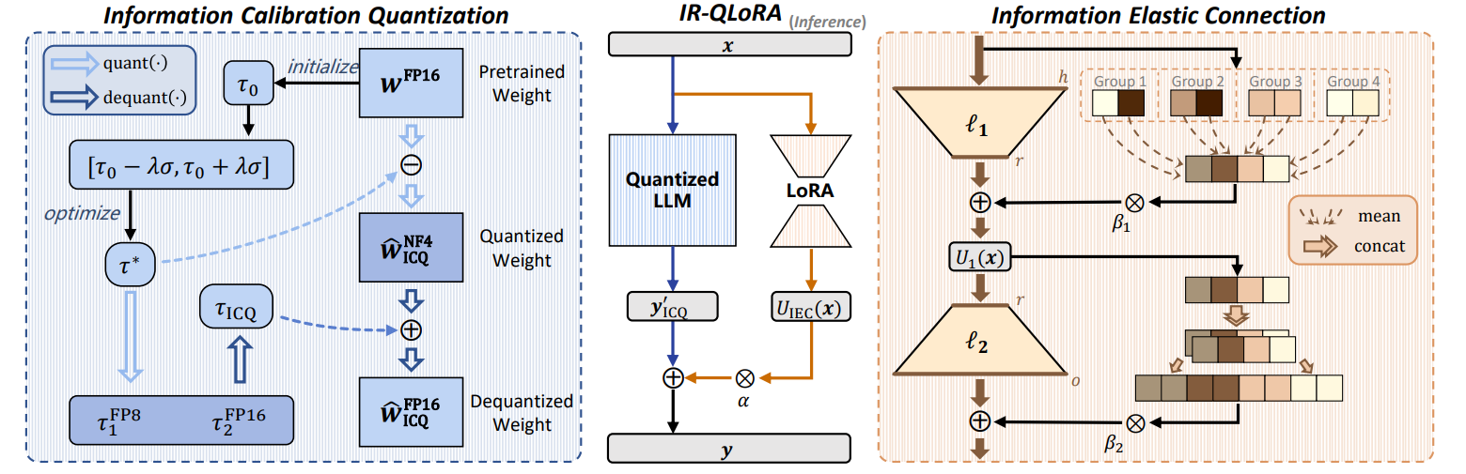
IR-QLoRA
Accuracy Limits

